Slide 1
Eukaryotic and Prokaryotic Cells
Prokaryote = without a nucleus
Eukaryote = with a nucleus
Anandi R

Slide 2
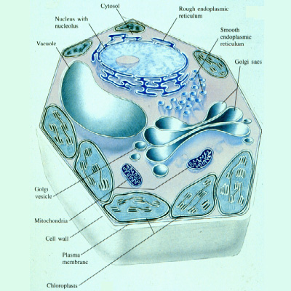
Eukaryotic cells

Slide 3
Components
Cytoplasm
Nucleus
Mitochondria
Chloroplast
Ribosomes
RER
SER
Golgi body
Vacuoles

Slide 4
Components cont.
Lysosomes
Cytoskeleton
Centriole
Cilium and Flagellum
Microvilli
Cell membrane
Cell Wall

Slide 5
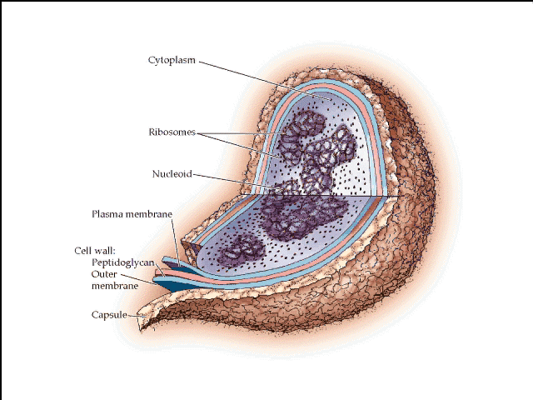
Prokaryotic cells

Slide 6
Components
Cytoplasm
Ribosomes
Nuclear Zone
DNA
Plasmid
Cell Membrane
Mesosome
Cell Wall
Capsule (or slime layer)
Flagellum

Slide 7
Summary of differences!
Prokaryotic Cells | Eukaryotic cells
small cells (< 5 mm) | larger cells (> 10 mm)
always unicellular | often multicellular
no nucleus or any membrane-bound organelles | always have nucleus and other membrane-bound organelles
DNA is circular, without proteins | DNA is linear and associated with proteins to form chromatin
ribosomes are small (70S) | ribosomes are large (80S)
no cytoskeleton | always has a cytoskeleton
cell division is by binary fission | cell division is by mitosis or meiosis
reproduction is always asexual | reproduction is asexual or sexual

Slide 8
Basic terminology
Anticodon
A sequence of three bases in tRNA that is complementary to a codon in mRNA. Enables tRNA to sequence amino acids in the order specified by mRNA.
Autosome
A non-sex chromosome. Synonymous with somatic chromosomes (chromosome pairs 1-22).

Slide 9
Basic terminology
Chromosome
Rod-shaped structures within the cell nucleus that carry genes encoded by DNA.
Cis position
Genes in the cis position are on the same chromosome of a pair of homologous chromosomes.
Cloned gene
A recombinant DNA molecule with the gene of interest.

Slide 10
Basic terminology
Co-dominant
Genes are co-dominant if both alleles are expressed in the heterozygous state, e.g., K and k genes
Codon
A sequence of three bases in DNA or RNA that codes for a single amino acid. Enables specific proteins to be made by specific genes.

Slide 11
Basic terminology
Crossing over
The exchange of genetic material between members of a pair of homologous chromosomes.
Deletion
An abnormality in which part of a chromosome (carrying genetic material) is lost.

Slide 12
Basic terminology
Diploid number of chromosomes
The number of chromosomes found in somatic cells, which in humans is 46.
DNA
Deoxyribonucleic acid. Composed of nucleic acids, these molecules encode the genes that allow genetic information to be passed to offsprings.

Slide 13
Basic terminology
DNA polymerases
Enzymes that can synthesize new DNA strands using previously synthesized DNA (or RNA) as a template.
DNA probe
A cloned DNA molecule labelled with a radioactive isotope (e.g., ³²P or ³⁵S) or a nonisotopic label (e.g. biotin). Used in molecular genetics to identify complementary DNA sequences by hybridizing to them.

Slide 14
Basic terminology
Dominant gene
A gene is dominant if it is expressed when heterozygous but its allele is not.
Functional genes
Genes that produce proteins, e.g., blood group genes that produce antigens.
Gene
A segment of a DNA molecule that codes for the synthesis of a single polypeptide.

Slide 15
Basic terminology
Gene interaction
The situation in which genes inherited at different loci.
Genome
Term used to denote the entire DNA sequence (gene content) of a gamete, person, population, or species.

Slide 16
Basic terminology
Homologous chromosomes
A matched pair of chromosomes, one from each parent.
Linkage
Genes are linked if they are on the same chromosome within a measurable distance of each other and are normally inherited together.
Locus
The location of allelic genes on the chromosome. (Plural = loci)

Slide 17
Basic terminology
Messenger RNA (mRNA)
Type of RNA polymerase using DNA as a template. Contains the codons that encompass the genetic codes to be translated into protein.
Nucleic acids
Polymers of phosphorylated nucleosides, the building blocks of DNA and RNA.

Slide 18
Basic terminology
Nucleoside
The building blocks of RNA and DNA. Compounds consisting of a purine (adenine or guanine) or pyrimidine (thymine or cytosine) attached to ribose (in RNA) or deoxyribose (in DNA) at the 1¹ carbon.

Slide 19
Basic terminology
Operator
A short sequence of nucleotides that controls the adjacent structural (functional) genes.
Operon
A postulated unit of gene action that consists of an operator and the closely linked functional genes it controls.

Slide 20
Basic terminology
Plasmid
Extrachromosomal circular DNA in bacteria. Plasmids can independently replicate and encode a product for drug resistance or some other advantage. Used in molecular genetics as vectors for cloned segments of DNA.

Slide 21
Basic terminology
Reverse transcriptase
An RNA-dependent DNA polymerase that synthesizes DNA from an RNA template. Used by retroviruses like the human immunodeficiency virus (HIV) to make proviral DNA from its RNA genome.
Transcription
Synthesis of single-stranded RNA by RNA polymerase using DNA as a template.

Slide 22
Basic terminology
Restriction fragment length polymorphisms (RFLP)
Regions of DNA of varying lengths that can be cut out of DNA by restriction endonucleases. Because the fragment lengths vary among individuals, they are polymorphic and can be used as genetic markers.

Slide 23
Basic terminology
Translation
The process of translating the codon sequence in mRNA into polypeptides with the help of tRNA and ribosomes.

Slide 24
Eukaryotic and prokaryotic genome

Slide 25
Genome
The word “genome,” coined by German botanist Hans Winkler in 1920, was derived simply by combining gene and the final chromosome.
An organism’s genome is defined as the complete haploid genetic complement of a typical cell.
In diploid organisms, sequence variations exist between the two copies of each chromosome present in a cell.
The genome is the ultimate source of information about an organism.

Slide 26
The number of genomes sequenced in their entirety is now in the thousands and includes organisms ranging from bacteria to mammals.
The first complete genome to be sequenced was that of the bacterium Haemophilus influenzae, in 1995.
The first eukaryotic genome sequence, that of the yeast Saccharomyces cerevisiae, followed in 1996.
The genome sequence for the bacterium Escherichia coli became available in 1997 .
The much larger effort directed at the human genome was also accelerating.

Slide 27
Prokaryotes and Eukaryotes genome
Prokaryotes | Eukaryotes
Single cell | Single or multi cell
No nucleus | Nucleus
One piece of circular DNA | Chromosomes
No mRNA post transcriptional modification | Exons/Introns splicing

Slide 28
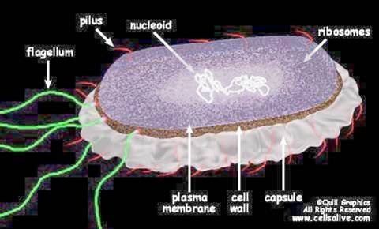
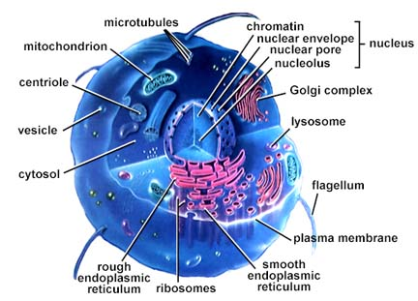
Prokaryotic and Eukaryotic Cells
Chromosomal differences
Prokaryotes
The genome of E.coli contains amount of 4X10⁶ base pairs
> 90% of DNA encode protein
Lacks a membrane-bound nucleus.
  Circular DNA and supercoiled domain
Histones not present

Slide 29
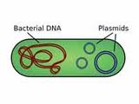
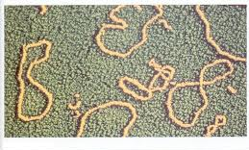
Continue…
Prokaryotic genomes generally contain one large circular piece of DNA referred to as a "chromosome" (not a true chromosome in the eukaryotic sense).
Some bacteria have linear "chromosomes".
Many bacteria have small circular DNA structures called plasmids which can be swapped between neighbors and across bacterial species.

Slide 30
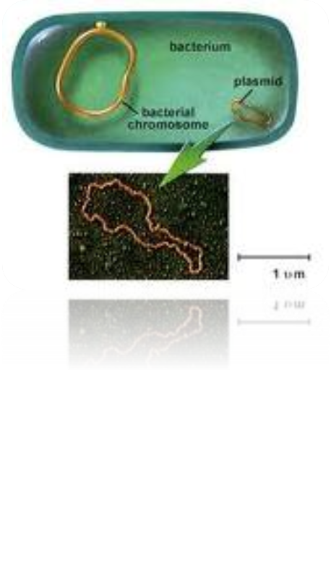
Plasmid
The term plasmid was first introduced by the American molecular biologist Joshua Lederberg in 1952.
A plasmid is separate from, and can replicate independently of, the chromosomal DNA.
Plasmid size varies from 1 to over 1,000 (kbp).

Slide 31
Continue…
Eukaryotes
The genome of yeast cells contains
1.35x10⁷ base pairs
A small fraction of the total DNA encodes protein.
  Many repeats of non-coding sequences
All chromosomes are contained in a membrane bound nucleus
  DNA is divided between two or more chromosomes
A set of five histones
  DNA packaging and gene expression regulation

Slide 32
Karyotype
The study of chromosomes, their structure and their inheritance is known as Cytogenetics.
Each species has a characteristic number of chromosomes and this is known as karyotype.
Bacteria 1
Fruit fly 8
Garden Pea 14
Yeast 16
Frog 26
Cat 38
Fox 34
Mouse 40
Rat 42
Rabbit 44
Human 46
Chicken 78

Slide 33
Continue…
Prior to 1950's it was believed that humans had 48 chromosomes but in 1956 it was confirmed that each human cell has 46 chromosomes (Tjio and Levan, 1956).
On the chromosomes the genes are situated in a linear order.
Each gene has a precise position or locus.
The size of bacterial chromosomes ranges from 0.6 -10 Mbp, and the size of Archael range from 0.5 - 5.8 Mbp, whereas Eukaryotic chromosomes range from 2.9 - 4,000 Mbp.

Slide 34
Bacterial genome
Bacterial genomics can give us a broader understanding of how a bacteria functions, a bacterias origins, and what bacteria live in our world that we can study by their DNA.
Of medical interest, bacterial genomics is also anticipated to play a significant role in speeding up the development of better therapies and vaccines for controlling disease-causing bacteria.
It will also be the cornerstone of anticipated DNA- based diagnostic tools that will hopefully enable doctors to make quicker, more accurate diagnoses of infectious disease.

Slide 35
Size of Bacterial genome
The size of Bacterial chromosomes ranges from 0.6 Mbp to over 10 Mbp
The smallest Bacterial genome identified thus far is from Mycoplasma genitalium, an obligate intracellular pathogen with a genome size of 0.58 Mbp (580 Kbp).
M. genitalium is restricted to the intracellular niche because it lacks genes encoding enzymes required for amino acid biosynthesis and the peptidoglycan cell wall, genes encoding TCA cycle enzymes, and many other biosynthetic genes.

Slide 36
Size of Bacterial genome
The smallest free-living organisms have a genome size over 1 Mbp.
Currently largest sequenced prokaryotic genome is streptomyces, 8.7 Mbp.
The average gene content is 3,100 genes per genome.

Slide 37
General features of Bacterial Chromosomes
Not all bacteria have a single circular chromosome.
some bacteria have multiple circular chromosomes.
Many bacteria have linear chromosomes and linear plasmids.
In 1989, pulsed field gel electrophoresis had been developed, and this new technique provided convincing evidence that the chromosome of Borrelia burgdoferi was linear.
Agrobacterium tumefacians: One linear (2.1 Mb) +One circular (3.0 Mb) + Two circular plasmids (450 kb + 200 Kb)

Slide 38
Genome Packaging in Prokaryotes
Prokaryotic cells donot contain nuclei or other membrane-bound organelles.
In fact, the word "prokaryote"literally means "before the nucleus."
The nucleoid is simply the area of a prokaryotic cell in which the chromosomal DNA is located.

Slide 39
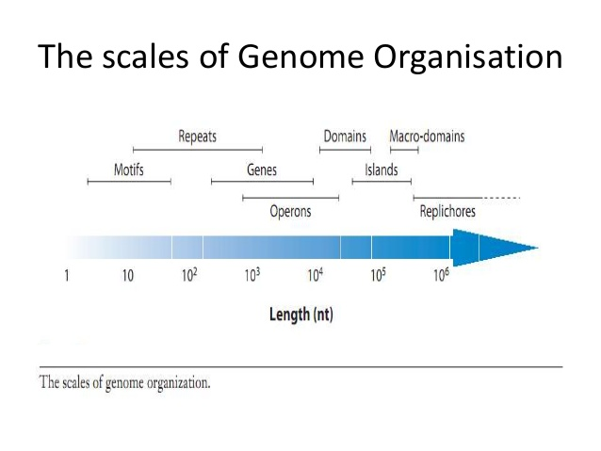
The scales of Genome Organisation

Slide 40
The scales of Genome Organisation
Replichores
Are the halves of the chromosome between the origin of replication and terminus region in the vicinity of the dif site.
Sequence motifs
Is a nucleotide or amino acid sequence pattern
Genomic islands
It’s a code for symbiosis or pathogenesis.

Slide 41
DNA Supercoiling
One way prokaryotes compress their DNA into smaller spaces is through supercoiling.
Genomes can be negatively supercoiled, meaning that the DNA is twisted in the opposite direction of the double helix, or positively supercoiled, meaning that the DNA is twisted in the same direction as the double helix.
Most bacterial genomes are negatively supercoiled during normal growth.

Slide 42
Proteins Involved in Supercoiling
Multiple proteins act together to fold and condense prokaryotic DNA.
In particular, one protein called HU, which is the most abundant protein in the nucleoid, works with an enzyme called topoisomerase I to bind DNA and introduce sharp bends in the chromosome, generating the tension necessary for negative supercoiling.
Integration host factor (IHF), can bind to specific sequences within the genome and introduce additional bends.

Slide 43
Proteins Involved in Supercoiling
The folded DNA is then organized into a variety of conformations that are supercoiled and wound around tetramers of the HU protein, much like eukaryotic chromosomes are wrapped around histones.
Once the prokaryotic genome has been condensed, DNA topoisomerase I, DNA gyrase, and other proteins help maintain the supercoils.

Slide 44
Operons
When different genes are to be expressed in exactly the same amount because they are part of a complex, transcription of all genes in a single transcript diminishes gene expression.
Pairs of divergently oriented operons show correlated expression levels this is because sometimes they share bidirectional regulatory regions that allow co regulation of the two operons.

Slide 45
